Slide 1
Security at the
Transport Layer:
SSL and TLS

Slide 2

Web Security Requirements
Secure Socket Layer
Transport Layer Security
Secure Electronic Transaction (SET)
Intruders,
Viruses
Related Threats

Slide 3
The World Wide Web is fundamentally a client/server application running over the Internet and TCP/IP intranets
1. Web Security Considerations
The WEB is very visible.
Web servers are easy to configure and manage.
Complex software hide many security flaws.
Users are not aware of the risks.

Slide 4
Web Security Threats
Passive attacks: eavesdropping on network traffic between browser and server and gaining access to a Web site
Active attacks: impersonating another user, altering messages in transit between client and server, and altering information on a web site
Another way to classify Web security threats is in terms of the location of the threat:
    Web server,
    Web browser, and
    network traffic between browser and server
Issues of server and browser security fall into the category of computer system security

Slide 5
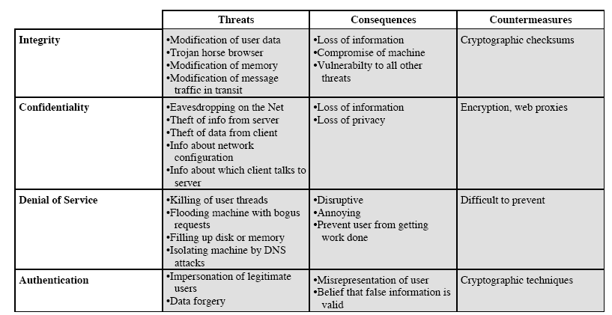
Issuses of traffic security fall into the category of network security

Slide 6
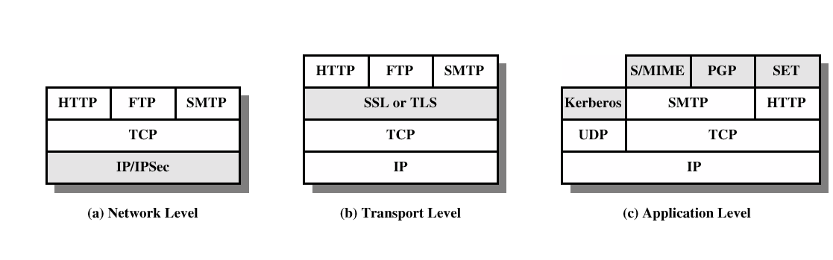
Web Traffic Security Approaches

Slide 7
2. SSL and TLS
TLS (Transport Layer Security) and SSL (Secure Sockets Layer) – protocols
provide data encryption and authentication between applications and servers, where that data is being sent across an insecure network
SSL was originated by Netscape
TLS working group was formed within IETF
First version of TLS can be viewed as an SSLv3.1

Slide 8
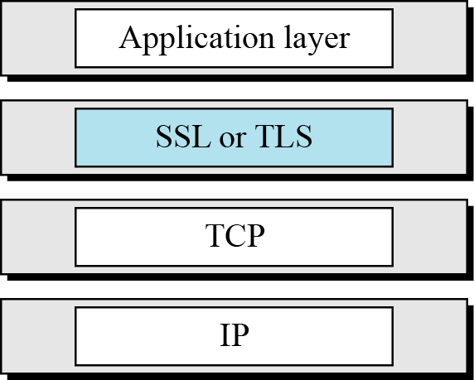
Figure Location of SSL and TLS in the Internet model

Slide 9
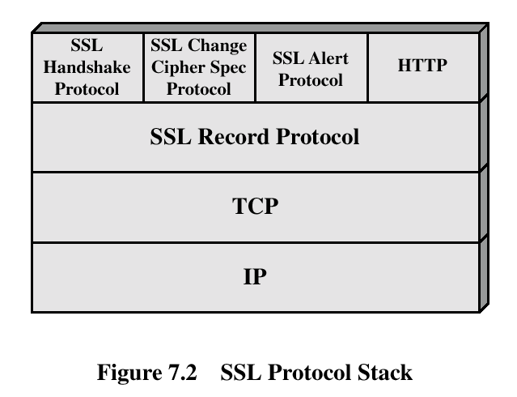
SSL ARCHITECTURE
SSL is designed to provide security and compression services to data generated from the application layer.
Services
Fragmentation
Compression
Message Integrity
Confidentiality
Framing

Slide 10
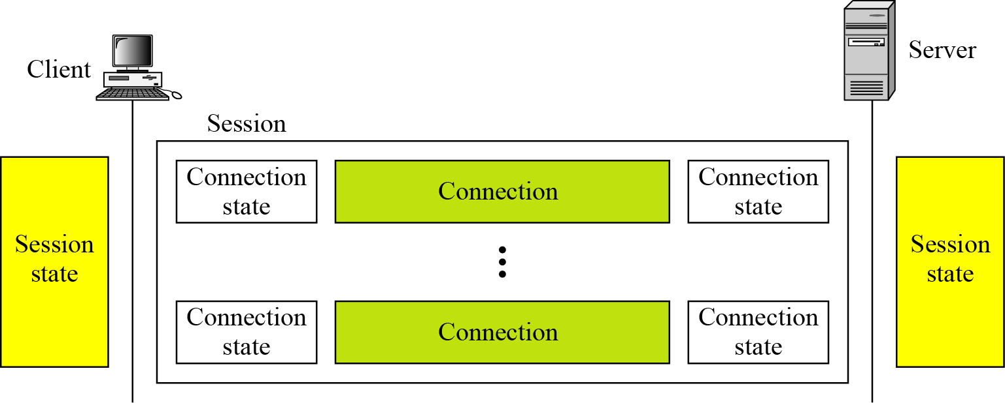
Sessions and Connections
2 important SSL concepts - SSL Connection and SSL Session.
Connection:
  It is a transport that provides a suitable type of service
  For SSL, connections are peer-to-peer relationships, transient
  Every connection is associated with one session
Session:
  It is an association between a client and a server
  Sessions are created by the Handshake protocol
Figure A session and connections

Slide 11
Sessions define a set of cryptographic security parameters, which can be shared among multiple connections
There are actually a number of states associated with each session
Once a session is established, there is a current operating state for both read and write (i.e., receive and send)
During the Handshake protocol, pending read and write states are created
At the end of the Handshake protocol pending states become the current states
(cryptographic security parameters)

Slide 12
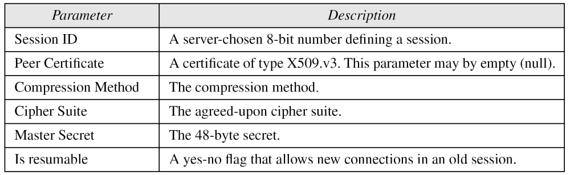
A session state is defined by the following parameters
Table Session state parameters
A connection state is defined by the following parameters

Slide 13

Server and client random | Byte sequences that are chosen by the server and client for each connection
Server write MAC secret | The secret key used in MAC operations on data sent by the server.
Client write MAC secret | The secret key used in MAC operations on data sent by the client
Server write key | The conventional encryption key for data encrypted by the server and decrypted by the client.
Client write key | The conventional encryption key for data encrypted by the client and decrypted by the server
Initialization vectors | When a block cipher in CBC mode is used, an initialization vector (IV) is maintained for each key. This field is first initialized by the SSL Handshake Protocol. Thereafter the final ciphertext block from each record is preserved for use as the IV for the next record.
Sequence numbers | Each party maintains separate sequence numbers for transmitted and received messages for each connection. When a party sends or receives a change CipherSpec message, the appropriate sequence number is set to zero.

Slide 14
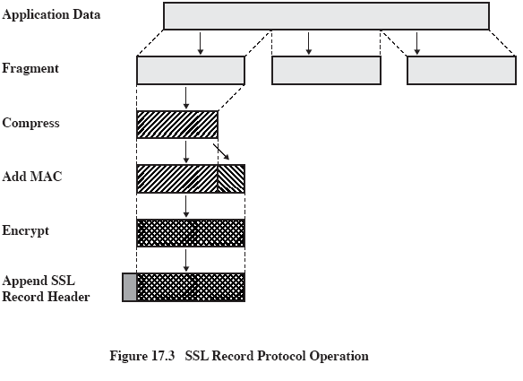
SSL Record Protocol- provide basic security services to various higher layer protocols

Slide 15
SSL Record Protocol : 2 services
The SSL Record Protocol provides two services for SSL connections
Confidentiality: The handshake protocol defines a shared secret key that is used for conventional encryption of SSL payloads
Message Integrity: The handshake protocol also defines a shared secret key that is used to form a MAC
  The Record protocol takes an application message to be transmitted,
    fragments the data into manageble blocks,
    optionally compress the data,
    applies a MAC,
    encrypts,
    adds a header, and
    transmits the resulting unit in a TCP segment.
  Received data is decrypted, verified, decompressed, and reassembled and then delivered to higher level users.

Slide 16
Step 1: Fragmentation. Each upper layer message is fragmented into blocks of 2¹⁴ bytes (16,384 bytes) or less
Step 2: Compression is optionally applied. Compression must be lossless and may not increase the content length by more than 1024 bytes
Step 3: compute a MAC over the compressed data. For this, a shared secret key is used.
  hash(MAC_write_secret || pad_2 ||
  hash(MAC_write_secret || pad_1 || seq_num ||
  SSLCompressed.type || SSLCompressed.length || SSLCompressed.fragment))
where
|| = concatenation
MAC_write_secret = shared secret key
hash = cryptographic hash algorithm;either SHA-1 or MD5
pad_1 = the byte 0x36 (0011 0110) repeated 48 times (384 bits) for MD5 and 40 times (320 bits) for SHA-1
pad-2 = the byte 0x5C (0101 1100) repeated 48 times for MD5 and 40 times for SHA-1
seq_num = the sequence number for this message
SSLCompressed.type = the higher level protocol used to process this fragment
SSLCompressed.length = the length of the compressed fragment
SSLCompressed.fragment = the compressed fragment (if compression is not used, the plaintext fragment)
Go to HMAC

Slide 17
Step 4: (Compressed message + MAC) are encrypted using symmetric encryption. Encryption may not increase the content length by more than 1024 bytes, so that the total length may not exceed 2¹⁴ + 2048.
Step 5: The final step of SSL Record Protocol processing is to prepend a header, consisting of the following fields:
  Content Type(8 bits): The higher layer protocol used to process the enclosed fragment
  Major Version(8 bits): Indicates major version of SSL in use. For SSLv3, the value is 3
  Minor Version(8 bits): Indicates minor version in use. For SSLv3, the value is zero
  Compressed Length(16 bits): The length in bytes of the plaintext fragment (or compressed fragment if compression is used). The maximum value is 2¹⁴ + 2048
Block Cipher |  | Stream Cipher
Algorithm | Key size | Algorithm | Key size
IDEA RC2-40 DES-40 DES 3DES Fortezza | 128 40 40 56 168 80 | RC4-40 RC4-128 | 40 128

Slide 18
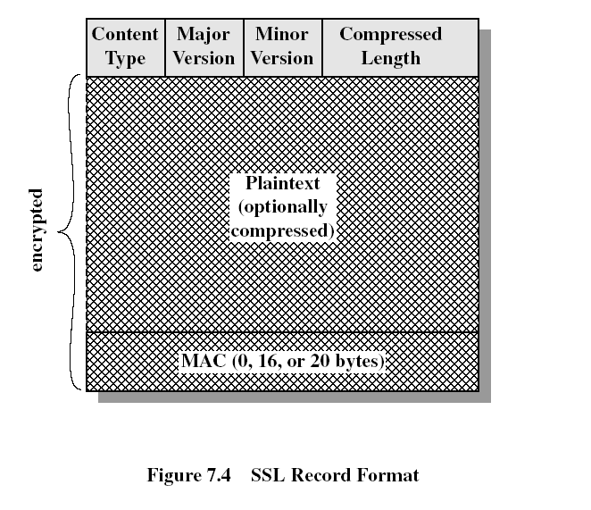
The content types defined are
  change_cipher_spec,
  alert,
  handshake, and
  application data

Slide 19
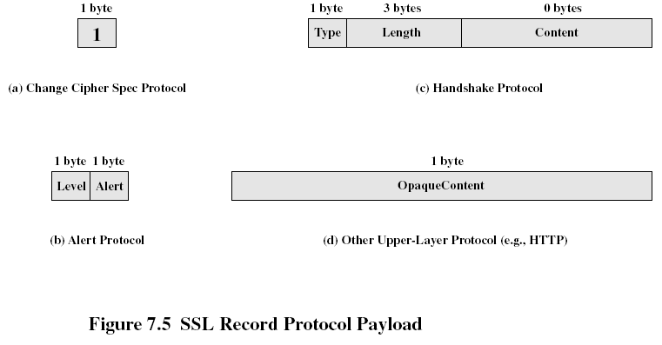
1. SSL Change Cipher Spec Protocol
This protocol consists of a single message (Fig 7.5a), → a single byte with value 1.
Purpose of this message: Copy the pending state into the current state, which updates the cipher suite to be used on this connection.
This signal is used as a coordination signal.
The client must send it to the server and the server must send it to the client.
After each side has received it, all of the following messages are sent using the agreed-upon ciphers and keys.

Slide 20
2. Alert Protocol
Purpose: To convey SSL-related alerts to the peer entity. Alert messages are compressed and encrypted, as specified by the current state.
Each message in this protocol consists of two bytes(Fig 7.5b).
The first byte takes the value warning(1) or fatal(2) to convey the severity of the message. If fatal, SSL immediately terminates the connection. Other connections on the same session may continue, but no new connections on this session may be established.
The second byte contains a code that indicates the specific alert.
Fatal Alerts are | The remaining alerts are
unexpected_message bad_record_mac decompression_failure handshake_failure illegal_parameter | close_notify no_certificate bad_certificate unsupported_certificate certificate_revoked certificate_expired certificate_unknown

Slide 21
3. Handshake Protocol
Purpose: Allows the server and client to authenticate each other and to negotiate an encryption and MAC algorithm and cryptographic keys to be used to protect data sent in an SSL record
The handshake Protocol is used before any application data are transmitted
The Handshake Protocol consists of a series of messages exchanged by client and server. All of these have the format shown in Fig 7.5c. Each message has three fields
Type(1 byte): Indicates one of 10 messages (table 7.2)
Length(3 bytes): The length of the message in bytes
Content( ≥ 1 byte): The parameters associated with this message (table 7.2)
>=

Slide 22
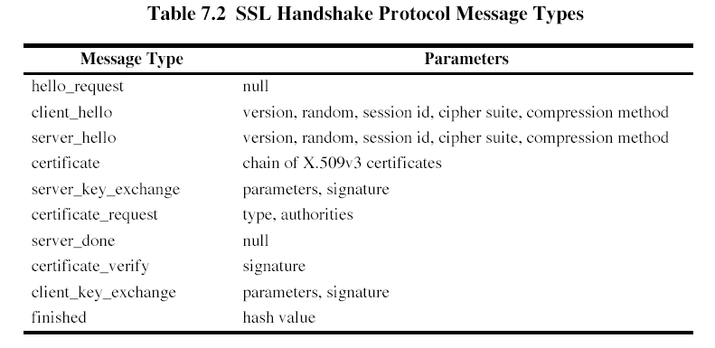

Slide 23
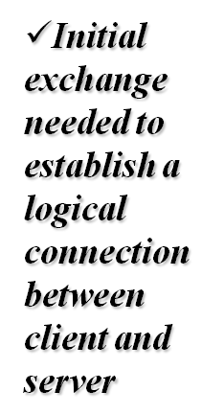
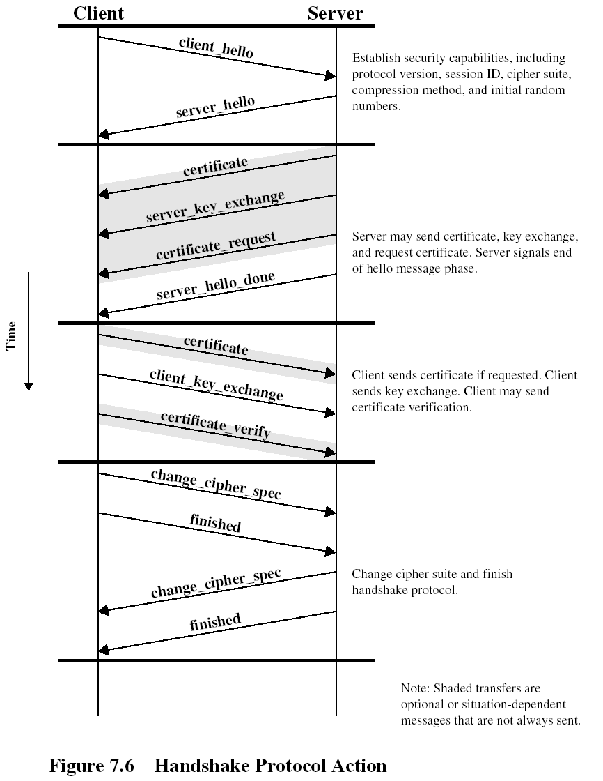

Slide 24
This exchange has four phases
Phase 1: Establish Security Capabilities
The exchange is initiated by the client, which sends a client_hello message with the following parameters
Version, Random, Session ID, CipherSuite, Compression Method
After sending the client_hello message, the client waits for the server_hello message, which contains the same parameters as the client_hello message
The 1st element of the CipherSuite parameter is the key exchange method (i.e., the means by which the cryptographic keys for conventional encryption and MAC are exchanged)
  RSA, Fixed Diffie-Hellman, Ephemeral Diffie-Hellman, Anonymous Diffie-Hellman, Fortezza
Following it is CipherSpec, which includes the fields:
  CipherAlgorithm, MAC algorithm, CipherType, IsExportable, HashSize, Key Material, IV Size

Slide 25
Phase 2: Server Authentication and Key Exchange
Phase 3: Client Authentication and Key Exchange
Phase 4: Finish
3. Transport Layer Security
TLS is an IETF standardization initiative whose goal is to produce an Internet standard version of SSL
TLS is very similar to SSLv3
Version Number: The TLS Record Format is the same as that of the SSL Record Format
Message Authentication Code: There are two differences between the SSLv3 and TLS MAC schemes:
  Actual algorithm and
  Scope of the MAC calculation.

Slide 26
TLS makes use of HMAC algorithm
HMAC_{k} = H[(K⁺ opad) || H[(K⁺ ipad) || M]] (original of Unit -2)
where
H = embedded hash function(MD5 or SHA-1)
M = message input to HMAC
K⁺ = secret key padded with zeros on the left(for MD5 and SHA-1, block length=512 bits)
ipad = 00110110(Ox36) repeated 64 times(512 bits)
opad = 01011100(0x5C) repeated 64 times(512 bits)
Note: SSLv3 uses the same algorithm, except that the padding bytes are concatenated with the secret key rather than being XORed with the secret key
For TLS, the MAC is calculated over the following fields
HMAC_hash(MAC_write_secret, seq_num || TLSCompressed.type || TLSCompressed.version ||TLSCompressed.length || TLSCompressed.fragment)
The MAC calculation covers all of the fields covered by the SSLv3 calculation, plus the field TLSCompressed.version

Slide 27
Pseudorandom Function (PRF):
TLS makes use of a pseudorandom function referred to as PRF to expand secrets into blocks of data for purposes of key generation or validation
P_hash(secret, seed) = HMAC_hash(secret, (A(1)||seed)) ||
HMAC_hash(secret, (A(2)||seed)) ||
HMAC_hash(secret, (A(3)||seed)) ||…
where A( ) is defined as
A(0) = seed
A(i) = HMAC_hash(secret, A(i-1))
This function makes use of the HMAC algorithm, with either MD5 or SHA-1

Slide 28
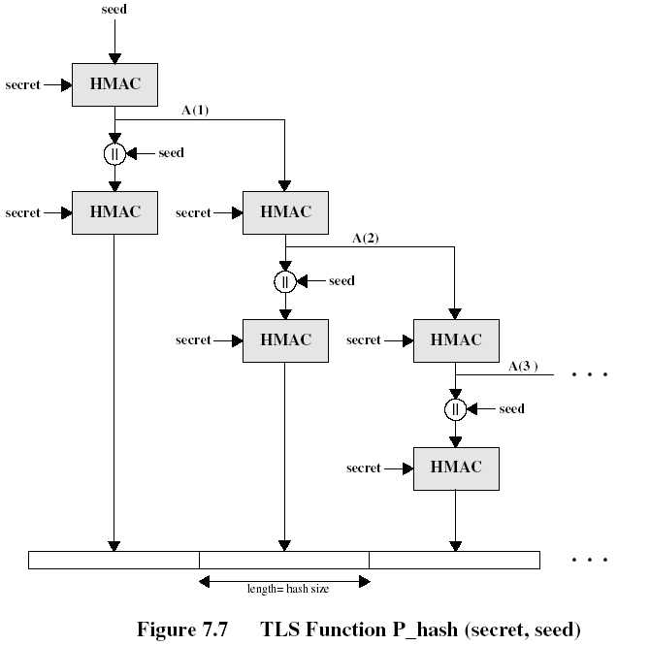

Slide 29
As can be seen, P_hash can be iterated as many times as necessary to produce the required quantity of data
Each iteration involves two executions of HMAC, each of which in turn involves two executions of the underlying hash algorithm
PRF is defined as
PRF(secret,label,seed) =
P_MD5(S1,label||seed) P_SHA-1(S2,label||seed)
Alert Codes: TLS supports all of the alert codes defined in SSLv3 with the exception of no_certificate. A number of additional codes are defined in TLS.
Fatal alerts are:
  decryption_failed, export_restriction
  record_overflow, protocl_version,
  unknown_ca, insufficient_security,
  access_denied, internal_error
  decode_error,

Slide 30
The remainder of the new alerts are:
decrypt_error, user_canceled, no_renegotiation
Cipher Suites:
There are several small differences between the cipher suites available under SSLv3 and under TLS:
Key Exchange: TLS supports all of the key exchange techniques of SSLv3 with the exception of Fortezza
Symmetric encryption algorithms: TLS includes all of the symmetric encryption algorithms found in SSLv3, with the exception of Fortezza

Slide 31
4. Secure Electronic Transaction (SET)
Definition
  SET is an open encryption and security specification designed to protect credit card transactions on the Internet
Who initiated it?
  Companies involved in developing the initial specification were IBM, Microsoft, Netscape, RSA, Terisa, and Verisign
What is it?
  SET is not a payment system,
  It is a set of security protocols and formats that enables users to employ the existing credit card payment infrastructure on an open network, such as the Internet, in a secure fashion

Slide 32
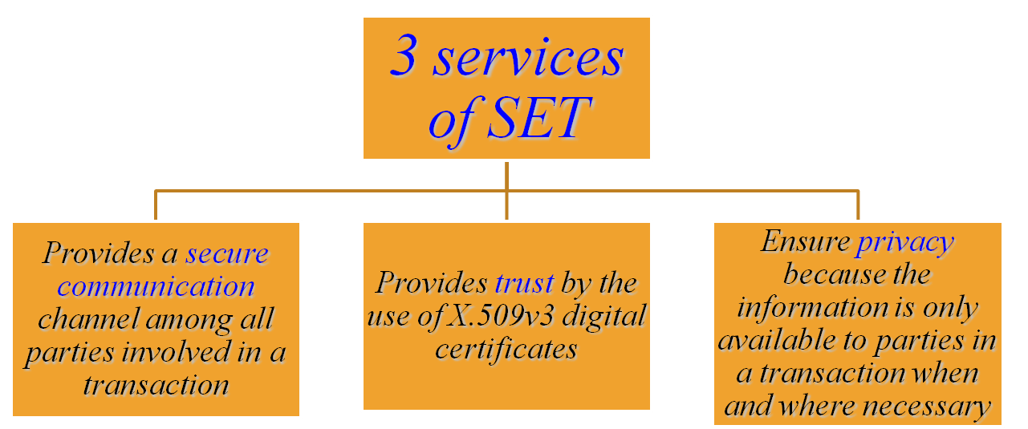

SET Overview

Slide 33
SET Overview: Requirements
Provide confidentiality of payment and ordering information
Ensure the integrity of all transmitted data
Provide authentication that a cardholder is a legitimate user of a credit card account
Provide authentication that a merchant can accept credit card transactions through its relationship with a financial institution
Ensure the use of the best security practices + system design techs to protect all legitimate parties in an e-commerce transaction
Create a protocol that neither depends on transport security mechanisms nor prevents their use.
Facilitate and encourage interoperability among software and network providers

Slide 34
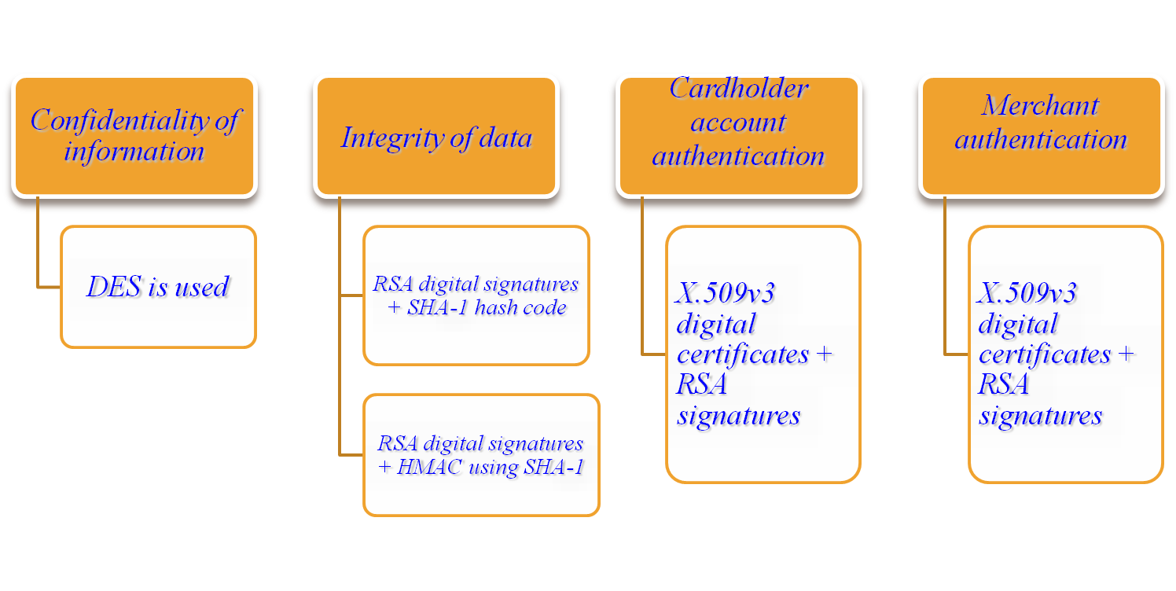
SET Overview: Key Features
To meet the requirements, SET incorporates the following features

Slide 35
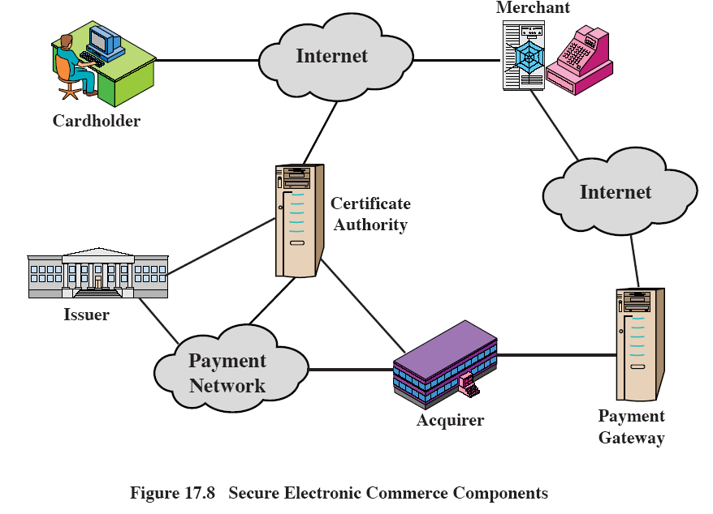
SET Overview: Participants

Slide 36
SET Participants
Cardholder: A cardholder is an authorized holder of a payment card (e.g., MasterCard, Visa)
Merchant: A merchant is a person or organization that has goods or services to sell to the cardholder
Issuer: This is a financial institution, such as a bank, that provides the cardholder with the payment card
Acquirer: This is a financial institution that establishes an account with a merchant and processes payment card authorizations and payments
Payment Gateway: This is a function operated by the acquirer or a third party that processes merchant payment messages
Certification Authority(CA): This is an entity that is trusted to issue X.509v3 public-key certificates for cardholders, merchants, and payment gateways

Slide 37
Sequence of events for a transaction
1.Customer opens an account
2.Customer receives a certificate
--X.509v3 digital certificate, which is signed by the bank
3.Merchants have their own certificates
--have two certificates, one for signing messages, and one for key exchange
4.Customer places an order
5.Merchant is verified
6.Order and payment is sent
7.Merchant requests payment authorization
8.Merchant confirms the order
9.Merchant provides the goods or service
10.Merchant requests payment

Slide 38
Dual Signature
Purpose : Link two messages that are intended for two different recipients
The customer want to send the order information(OI) to the merchant and the payment information(PI) to the bank
Customers send two messages to the merchant: a signed OI and a signed PI, and the merchant passes the PI on to the bank.
Motivation: The merchant may change the OI1 to OI2 and link the PI1 to OI2.
They need to be linked to address the disputed later, if any.

Slide 39
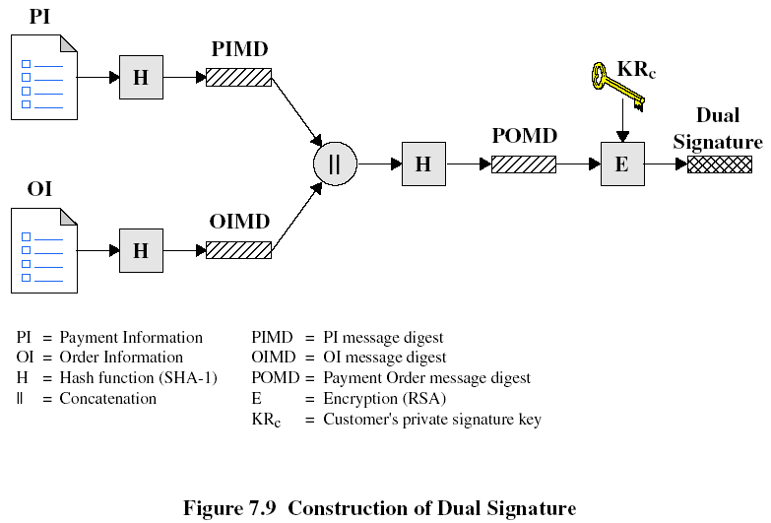
The operation can be summarized as follows:
DS = E_{KRc} [H( H(PI) || H(OI))]

Slide 40
Case 1: Consider if the merchant is in possession of DS, OI, and the PIMD.
The merchant also has the public key of the customer, taken from the customer’s certificate
Then the merchant can compute the following quantities
H(PIMD || H(OI)) and D_{KUc} [DS]
if these two quantities are equal, then the merchant has verified the signature
Case 2: If the bank is in possession of DS, PI, OIMD, and the customer’s public key, then the bank can compute the following
H(H(PI) || OIMD) and D_{KUc} [DS]
if these two quantities are equal, then the bank has verified the signature

Slide 41
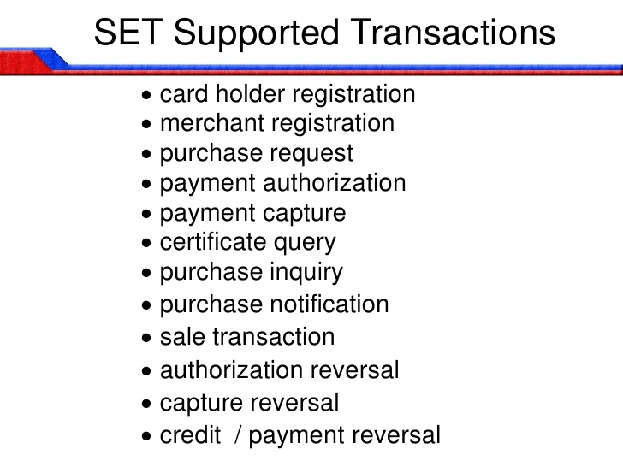
SET supports different transaction types. They are

Slide 42
Payment Processing
Purchase Request – Message from customer to merchant containing OI for merchant and PI for bank.
Before the purchase request exchange begins, the cardholder has completed browsing, selecting, and ordering
The purchase request exchange consists of four messages: Initiate Request, Initiate Response, Purchase Request, and Purchase Response
Initiate Request message: The customer requests the certificates (merchant and payment gateway) to the merchant.
The Initiate Response message : Merchant responds with his certificates and payment gateway
Next, the cardholder prepares the Purchase Request message (Fig 7.10)

Slide 43
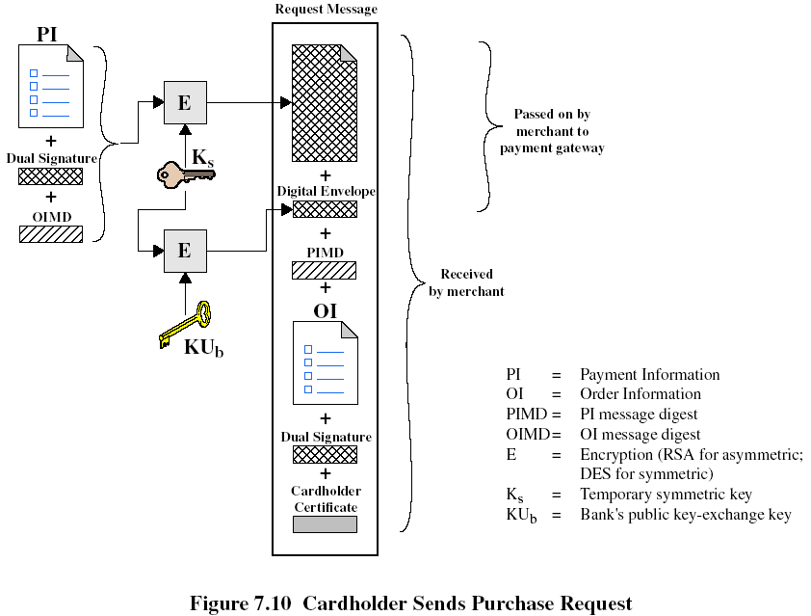
Purchase Request message includes the following:
  1.Payment-related information 2.Order-related information 3.Cardholder certificate

Slide 44
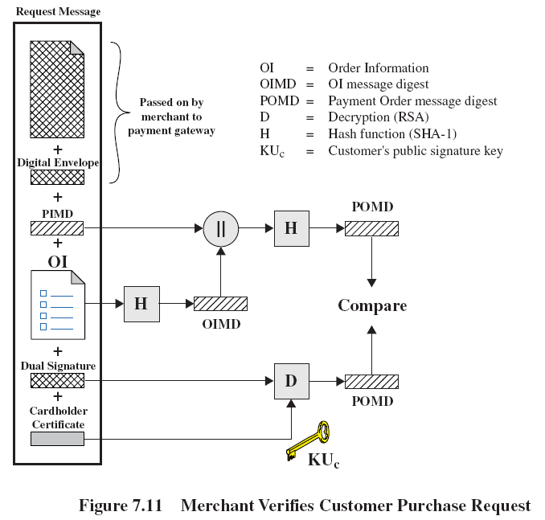
When the merchant receives the Purchase Request message, it performs the following
  1.Verifies the cardholder
  2.Forwards the payment information to the payment gateway for authorization
  3.Sends a purchase response to the cardholder

Slide 45
The Purchase Response message = DS(KR_{M}, response block that acknowledges the order)
The block and its signature are sent to the customer, along with the merchant’s signature certificate
When the cardholder receives the Purchase Response message, it verifies the signature on the response block
Payment Authorization
Exchange between merchant and payment gateway to authorize a given amount for a purchase on a given Credit card a/c.
During the processing of an order from a cardholder, the merchant authorizes the transaction with the payment gateway. This authorization guarantees that the merchant will receive payment. The merchant can therefore provide the services or goods to the customer.
The payment authorization exchange consists of two messages:
Authorization Request and Authorization Response

Slide 46
The merchant sends an Authorization Request message to the payment gateway consisting of
  1.Purchase-related information = PI || DS || OIMD || Digital Envelope
  2.Authorization-related information
  -Authorization block includes transaction ID
  -A digital envelope
  3.Certificates
  -Cardholder’s certificate
  -Merchant’s signature key certificate
  -Merchant’s key exchange certificate(needed in the payment gateway’s response)
The payment gateway performs the following tasks:
  1.Verifies all certificates
  2.Decrypts the digital envelope and decrypts the authorization block
  3.Verifies the Dual signature
The payment gateway returns an Authorization Response message to the merchant includes the following:
  1.Authorization-related information
  -Authorization block
  -Digital envelope
  2.Capture token information
  3.Certificate
  -The gateway’s signature key certificate

Slide 47
Payment Capture
To obtain payment, the merchant engages the payment gateway in a payment capture transaction, consisting of a capture request and a capture response message
The Capture Request message includes the following:
-Capture request block = payment amount || transaction ID ||
Encrypted capture token || Merchant’s certificates
When the payment gateway receives the capture request message, it decrypts and verifies the capture request block and verifies the capture token block
It then sends clearing request to the issuer over the private network. This request causes funds to be transferred to the merchant’s account
The gateway then notifies the merchant of payment in a Capture Response message. The message include the following:
-capture response block
-gateway’s signature key certificate

Slide 48
Appendix: HMAC (Unit II)
Use a MAC derived from a cryptographic hash code, such as SHA-1.
Motivations:
  Cryptographic hash functions executes faster in software than encryptoin algorithms such as DES
  Library code for cryptographic hash functions is widely available
  No export restrictions from the US.
A cryptographic hash function: hash function which takes an input (or 'message') and returns a fixed-size alphanumeric string, which is called the hash value (sometimes called a message digest, a digital fingerprint, a digest or a checksum).

Slide 49
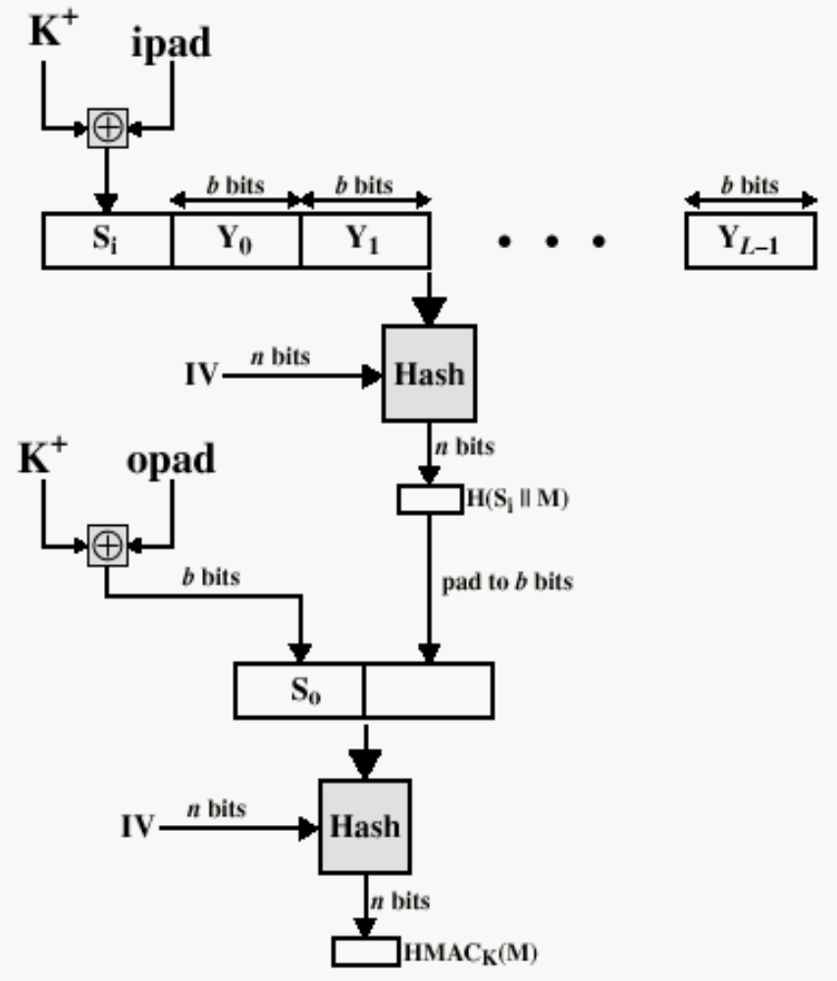
Henric Johnson
HMAC Structure

Slide 50
H = embedded hash function (e.g., SHA-1)
M = message input to HMAC (including the padding specified in the embedded hash function)
Y_{i} = i th block of M, 0 ≤ i ≤ (L-1)
L = number of blocks in M
b = number of bits in a block
n = length of hash code produced by embedded hash function
K = secret key;
K+ = K padded with zeros on the left so that the result is b bits in length
ipad = 00110110 (36 in hexadecimal) repeated b/8 times
opad = 01011100 (5C in hexadecimal) repeated b/8 times
Then HMAC can be expressed as follows:
HMAC_{k} = H[(K+ opad) || H[(K+ ipad) || M]]
Go to Slide 16

Slide 51
HMAC Algorithm
1.Append zeros to the left end of K to create a b-bit string K+ (e.g., if K is of length 160 bits and b=512, then K will be appended with 44 zero bytes 0x00).
2.XOR K+ with ipad to produce the b-bit block s_{i}
3.Append M to s_{i}
4.Apply H to the stream generated in step3
5.XOR K+ with opad to produce the b-bit block s₀
6.Append the hash result from step4 to s₀
7.Apply H to the stream generated in step6 and output the result.

